Slide 2
Rshiny workshop

Slide 3
Agenda:
Structure of Shiny apps
Example 1: Basic app, UI elements management, Widgets
Hands-on experience
Example 2: Server function
Hands-on experience
Example 3: Reactivity
Hands-on experience

Slide 4
Agenda:
Structure of Shiny apps
Example 1: Basic app, UI elements management, Widgets
Hands-on experience
Example 2: Server function
Hands-on experience
Example 3: Reactivity
Hands-on experience

Slide 5
The structure of Shiny apps
Shiny apps have 2 main components:
UI object
Controls the layout and appearance of your app
Server function
Controls the logic of the app and it contains a set of instructions to get the desired output based on the input given

Slide 6
Agenda:
Structure of Shiny apps
Example 1: Basic app, UI elements management, Widgets
Hands-on experience
Example 2: Server function
Hands-on experience
Example 3: Reactivity
Hands-on experience

Slide 7
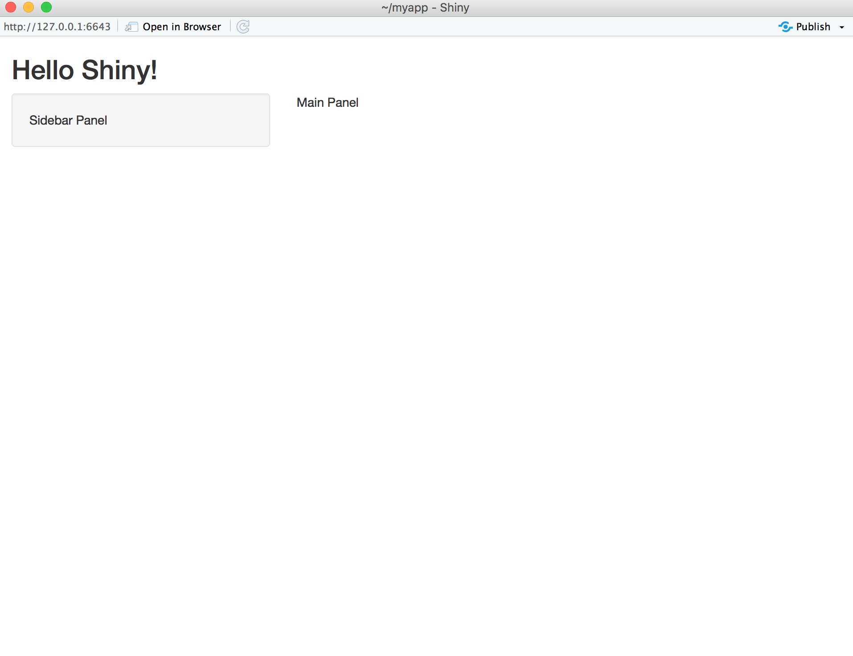
Add title
This basic app only has a UI, no data set is being used*
Sidebar Layout
*Code can be find in myapp_1 directory.

Slide 8
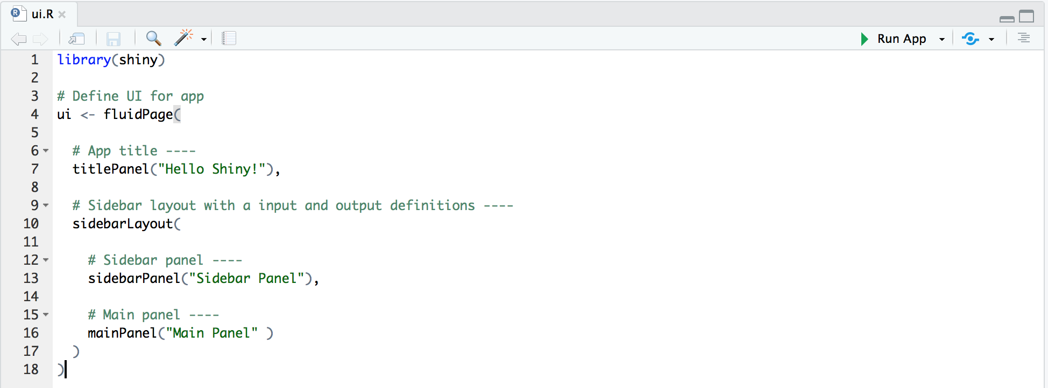
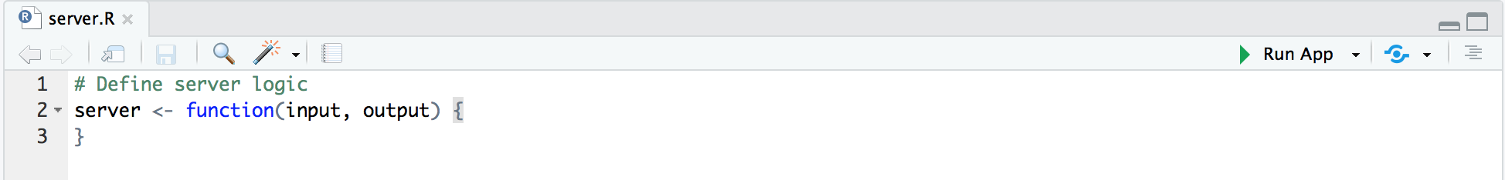
Try it out yourself! Try changing the element position to be “right” (position = “right”) inside sidebarLayout function.

Slide 9
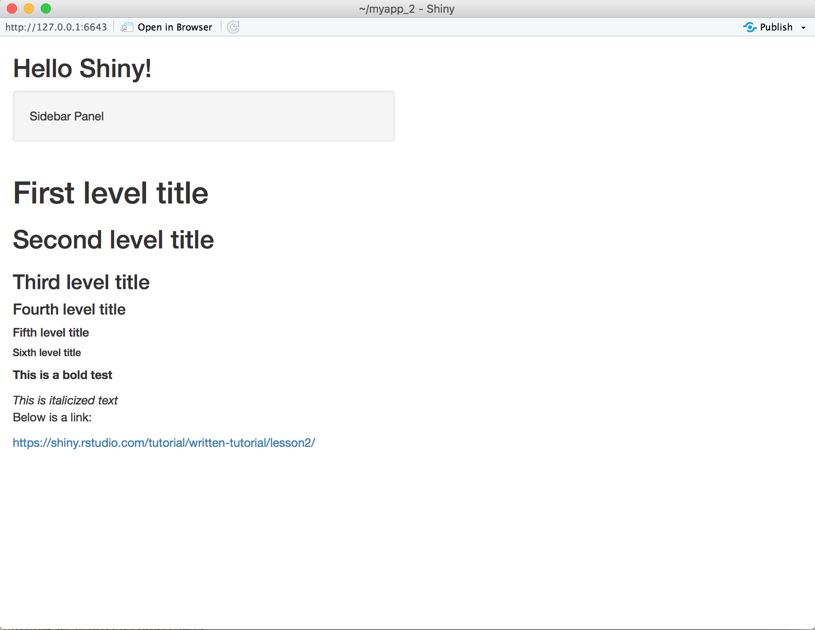

Slide 10
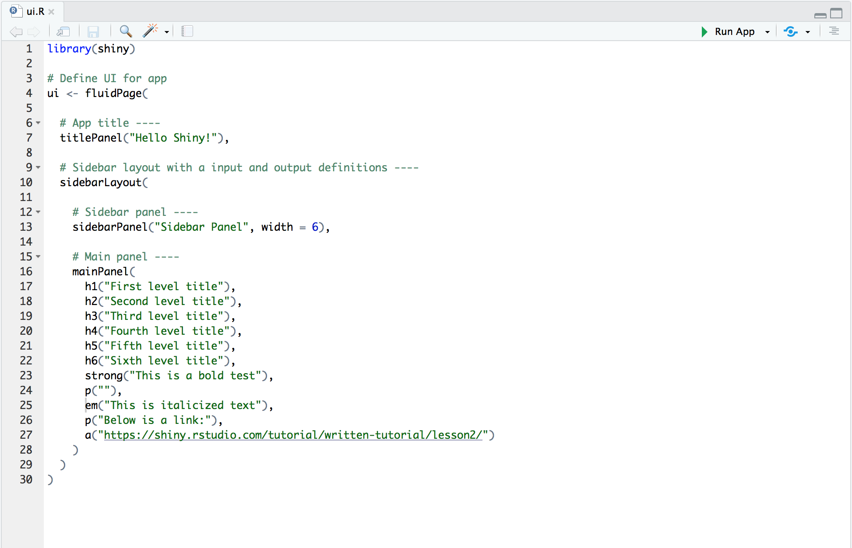

Slide 11
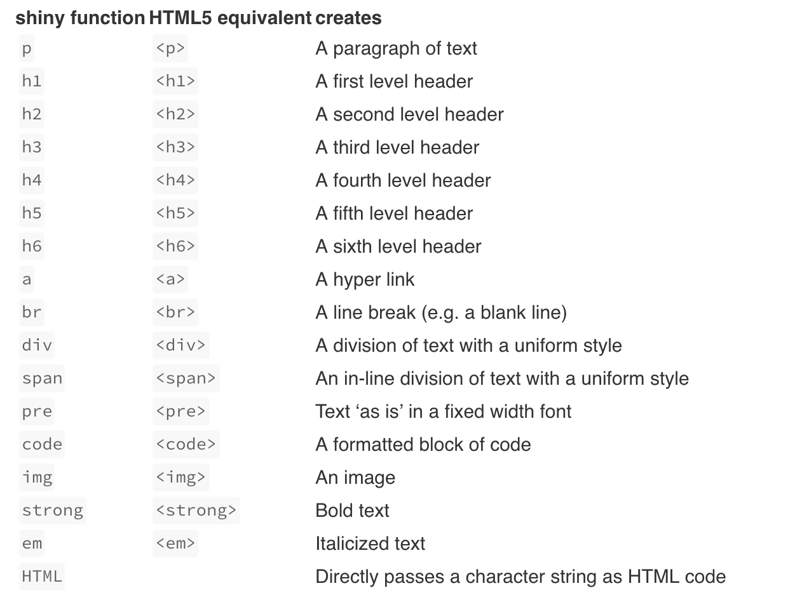

Slide 12
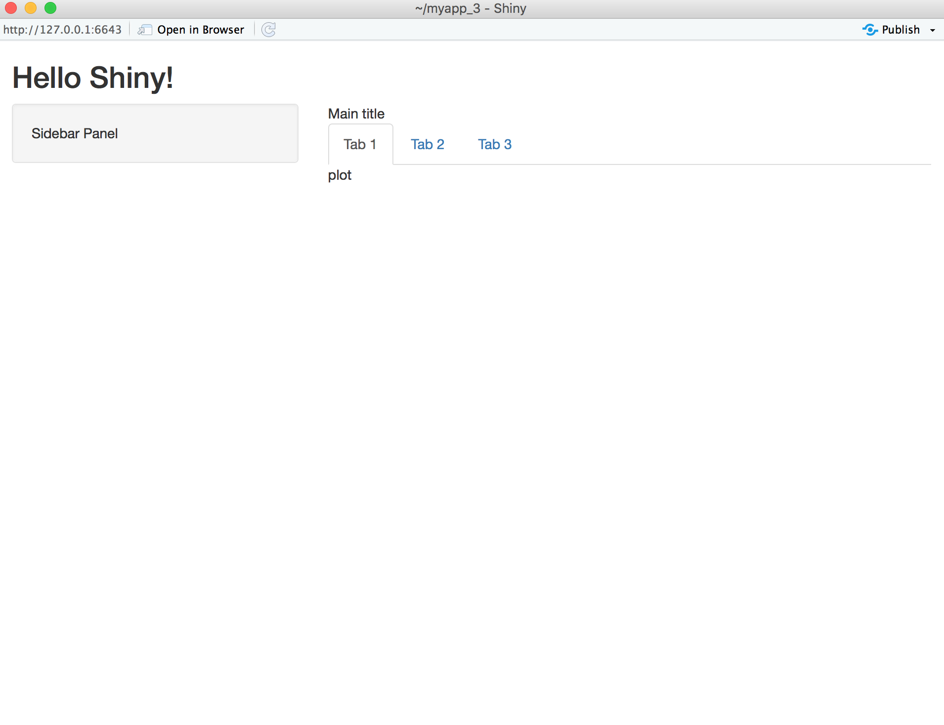

Slide 13
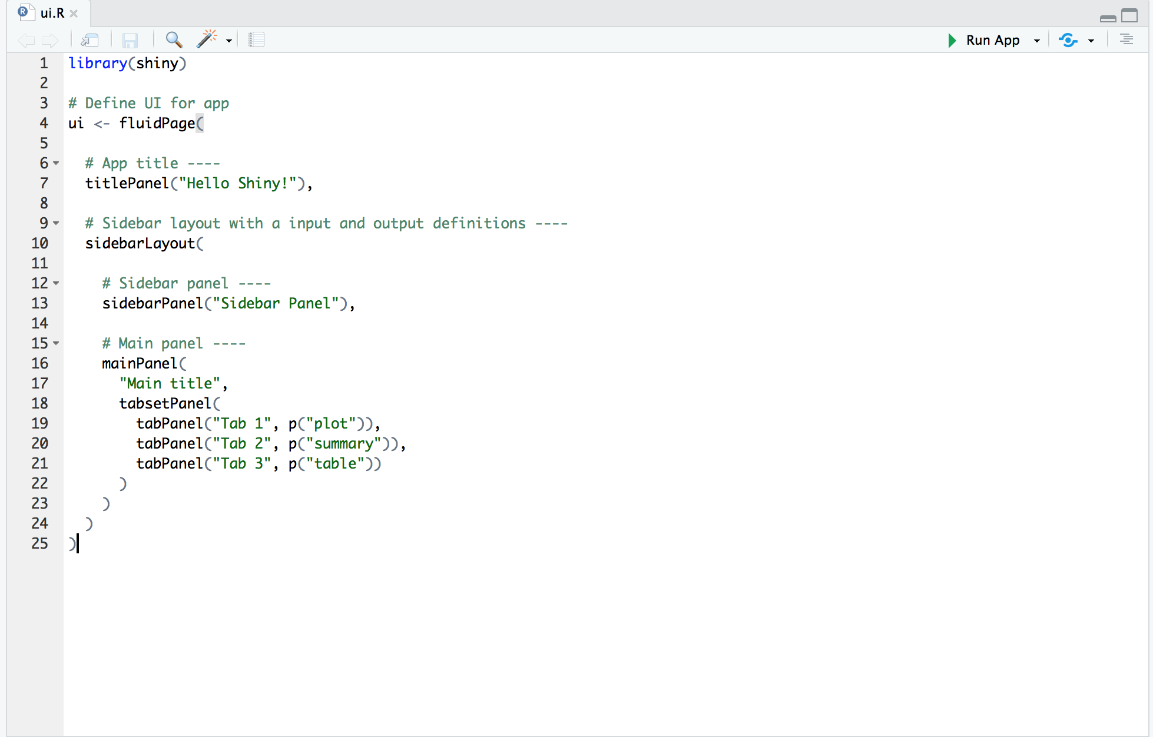

Slide 14
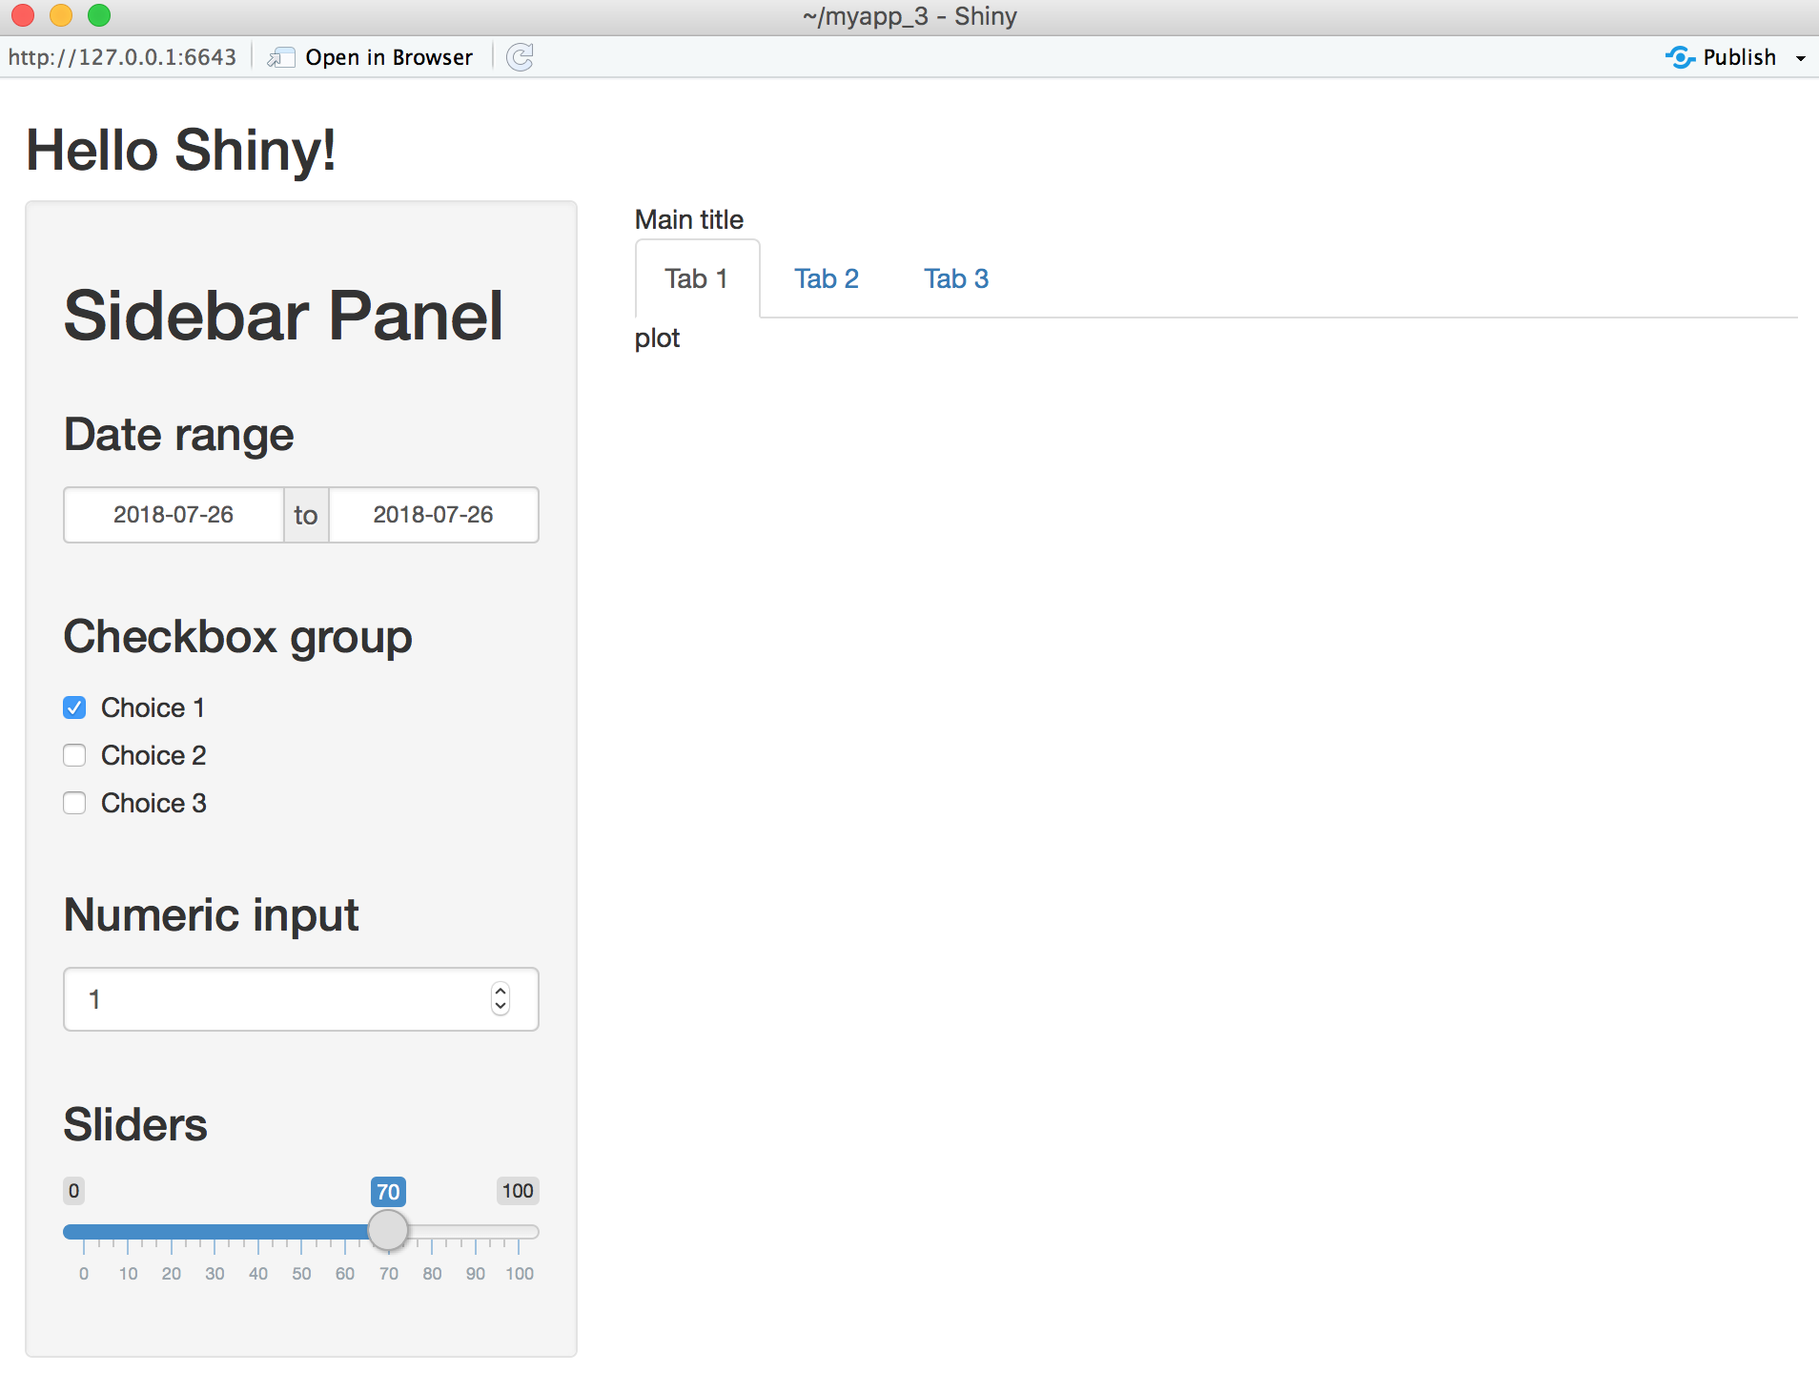

Slide 15
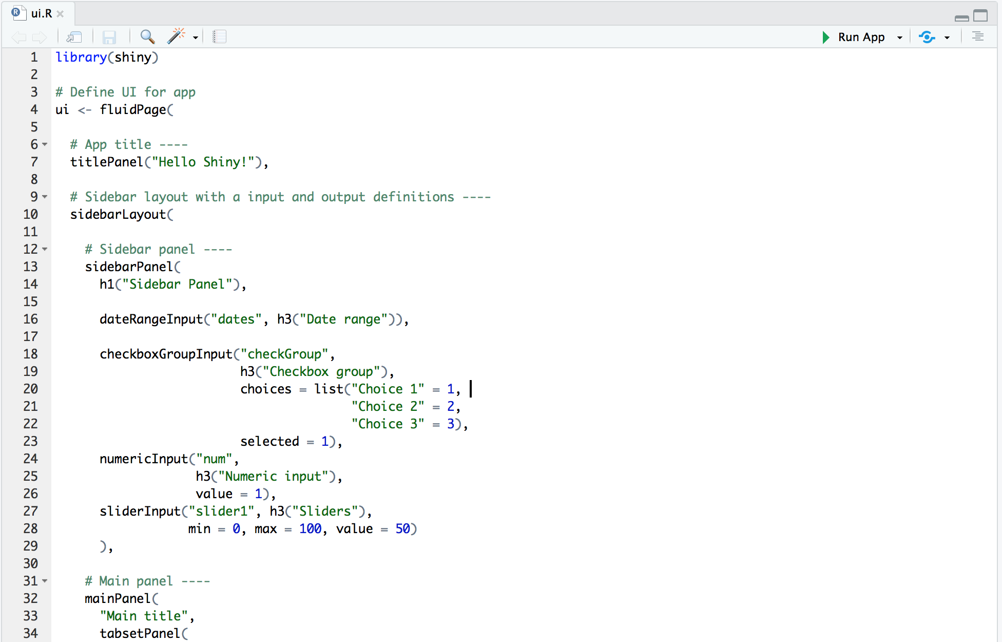

Slide 16
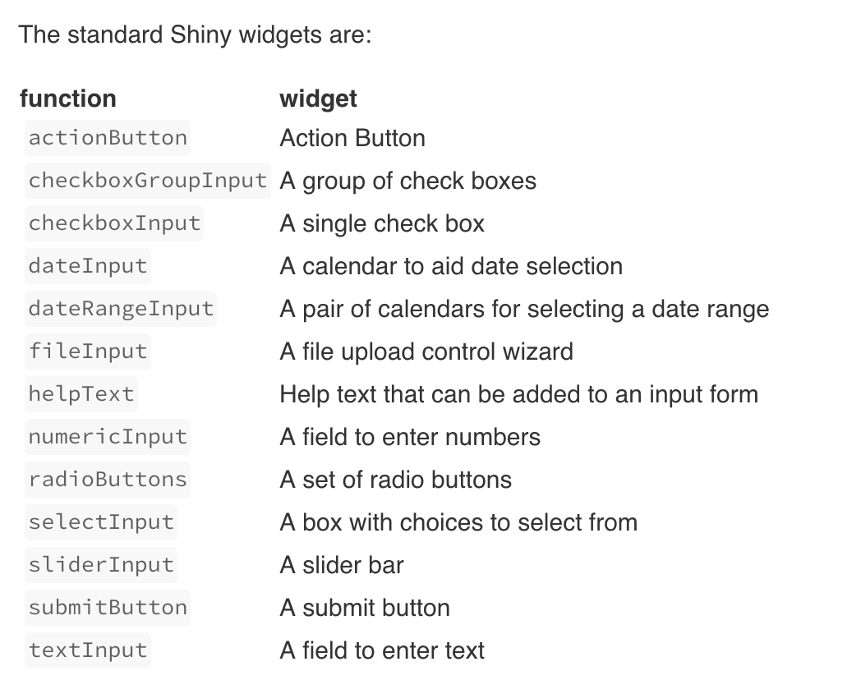

Slide 17
Agenda:
Structure of Shiny apps
Example 1: Basic app, UI elements management, Widgets
Hands-on experience
Example 2: Server function
Hands-on experience
Example 3: Reactivity
Hands-on experience

Slide 18
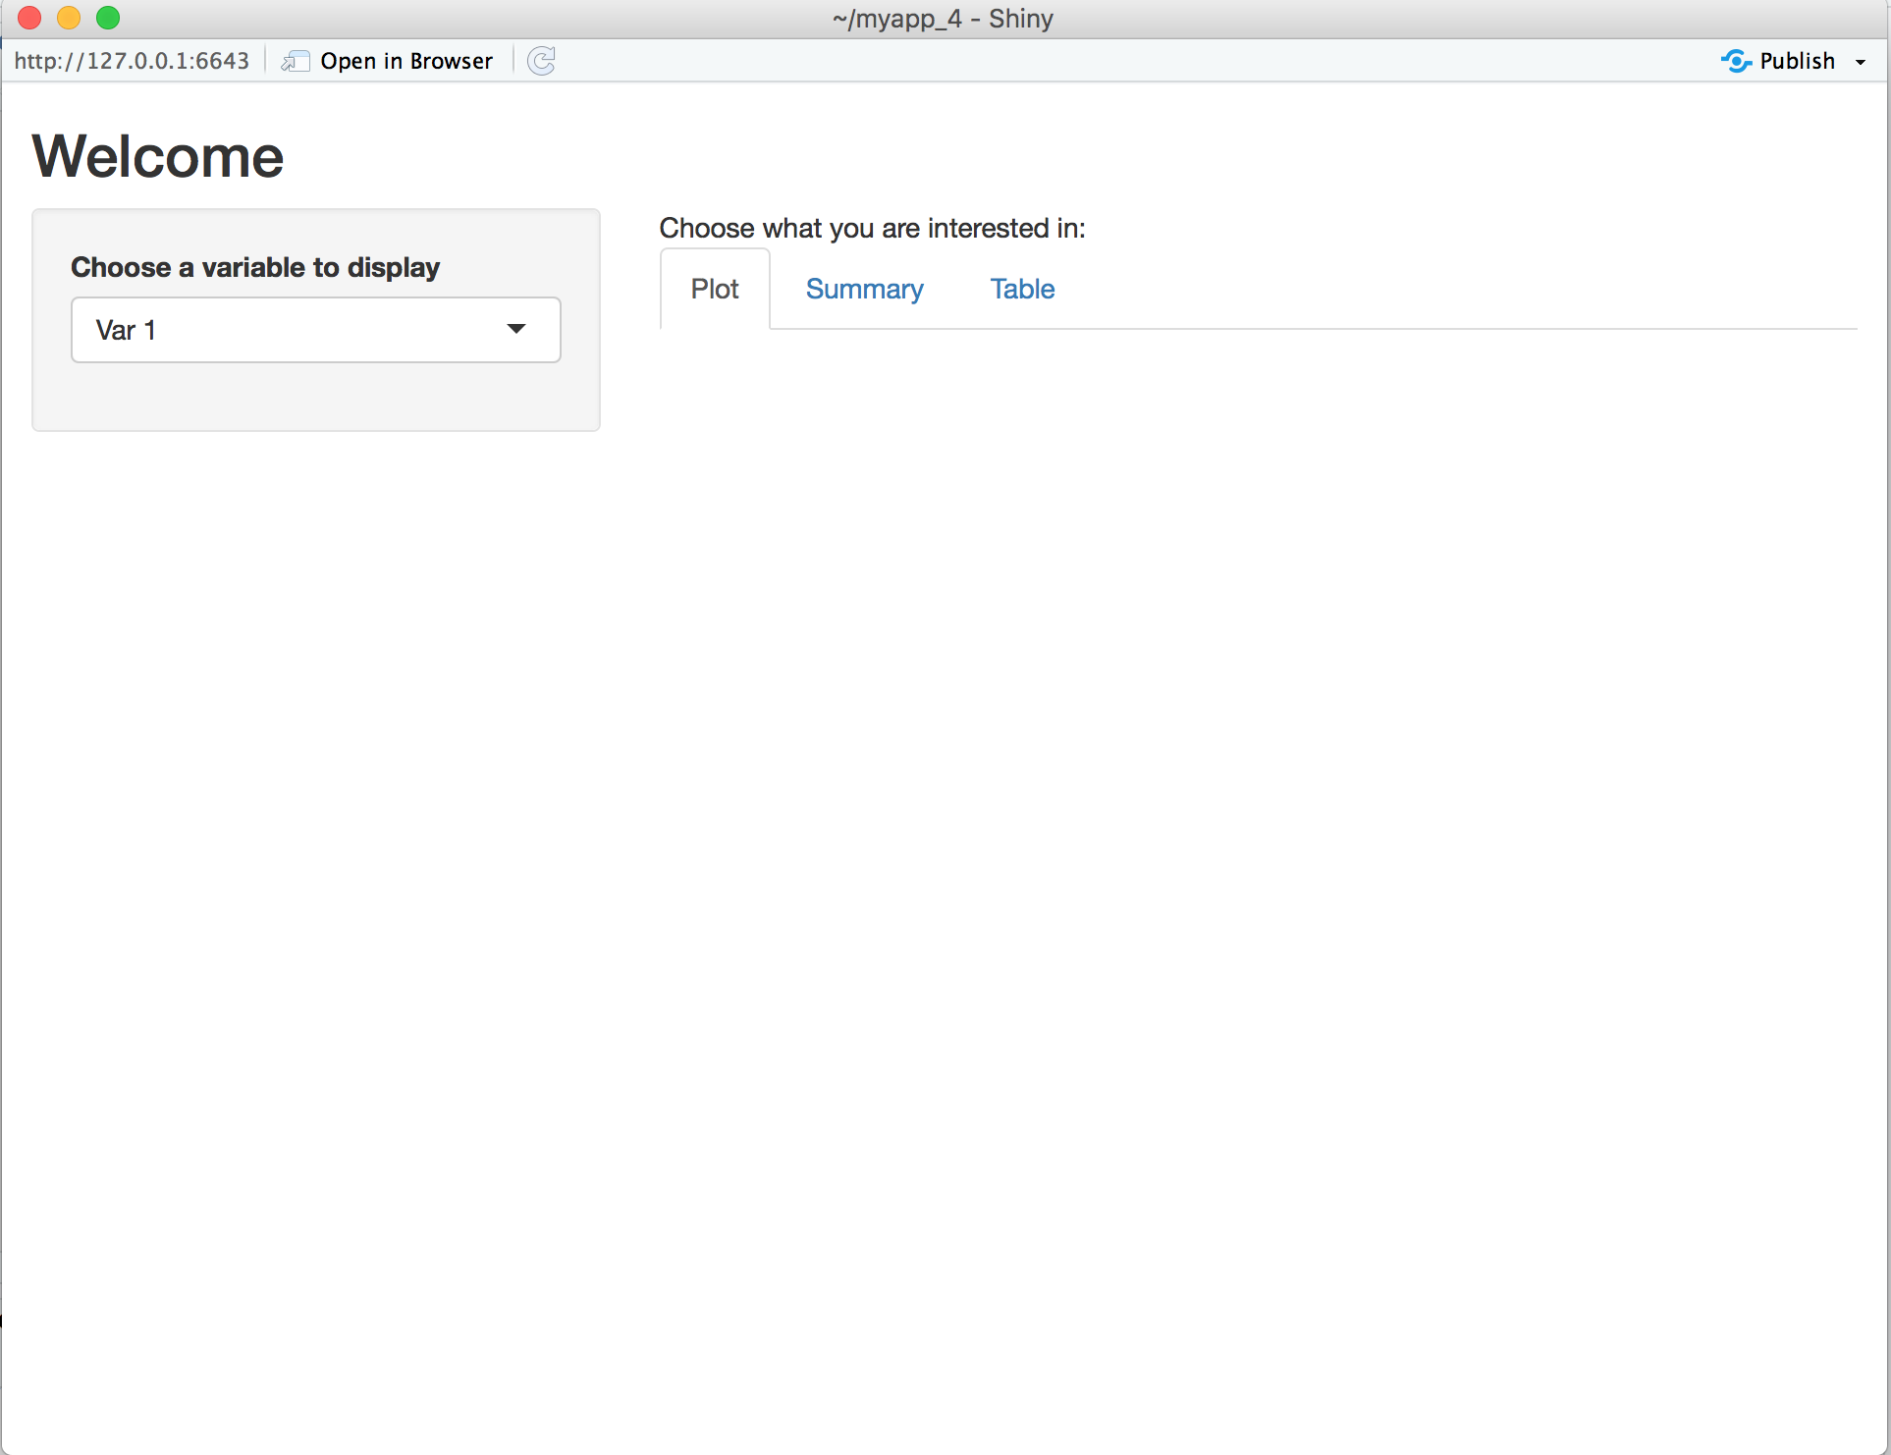
Create the following shiny app

Slide 19
Agenda:
Structure of Shiny apps
Example 1: Basic app, UI elements management, Widgets
Hands-on experience
Example 2: Server function
Hands-on experience
Example 3: Reactivity
Hands-on experience

Slide 20
It’s time to add information in our app
So far we only made changes in the ui function. This is in charge of how your app looks like
Now we need R objects to be displayed as output for our user interface. These could be: DataTable, text, plots, images etc.

Slide 21
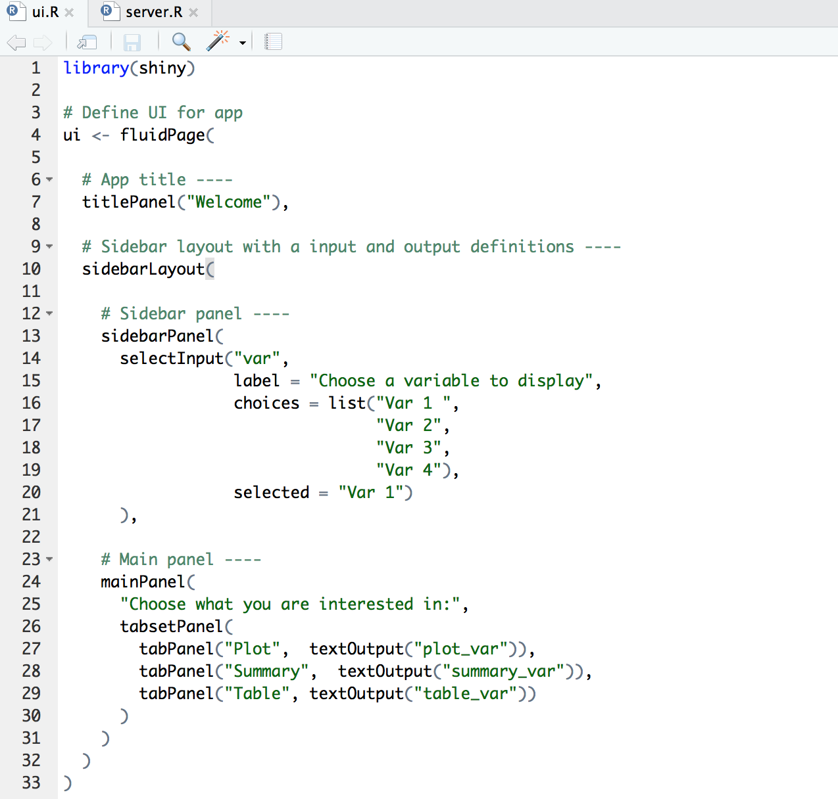
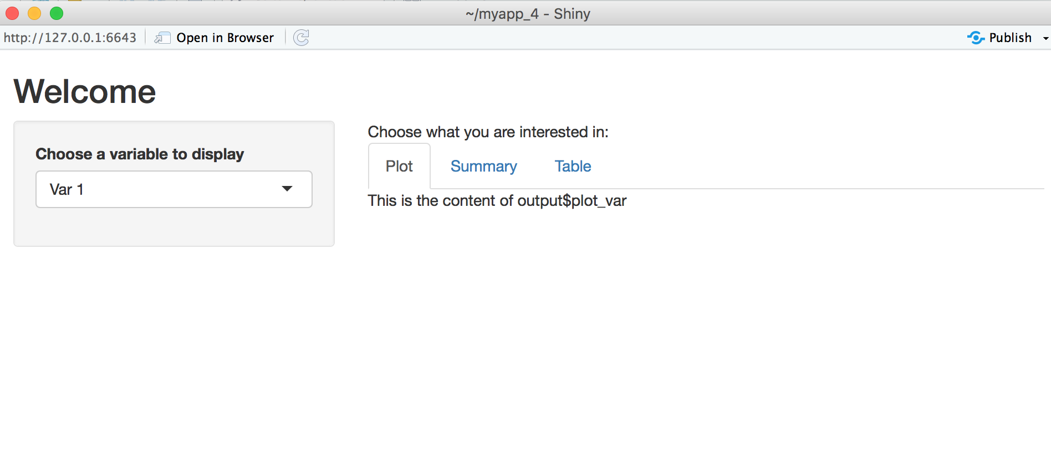
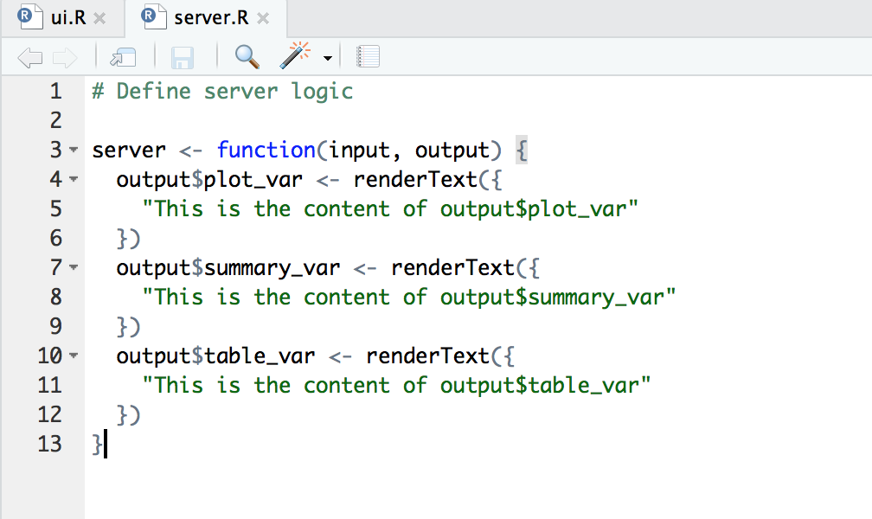
The server function builds a list-like object named “output”
Elements of ”output” will be used in ui function
First easy example: let’s add a text in each of the tabs we created

Slide 22
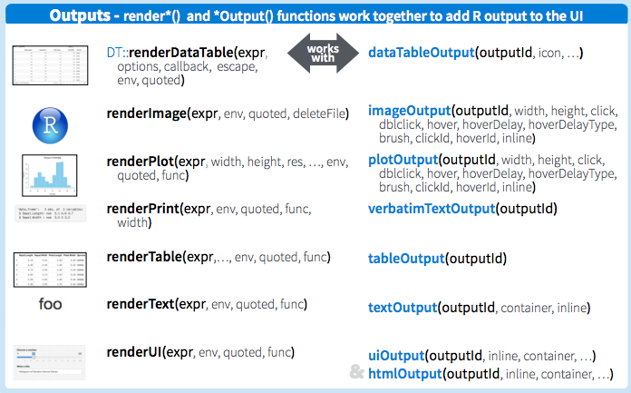
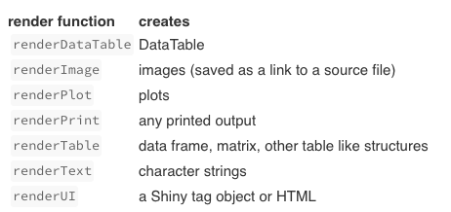

Slide 23
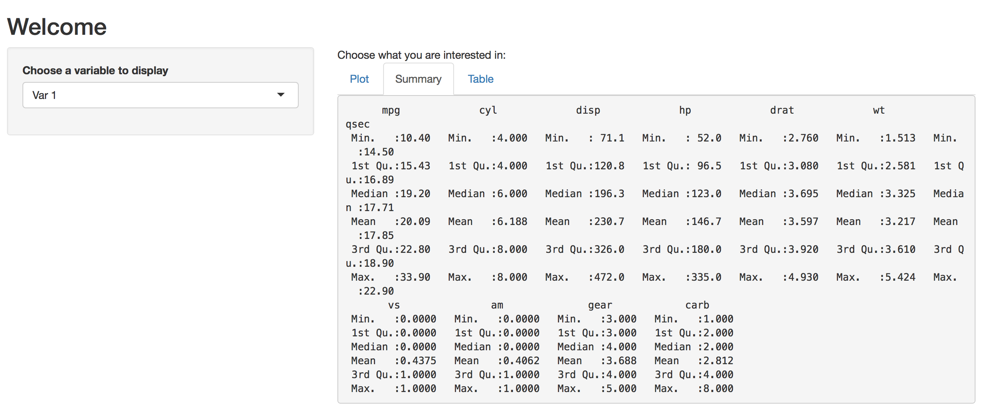

Slide 24
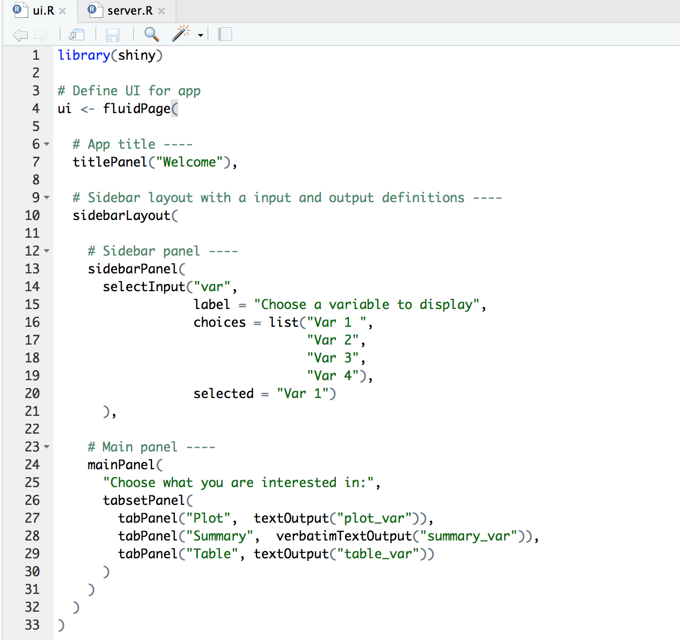
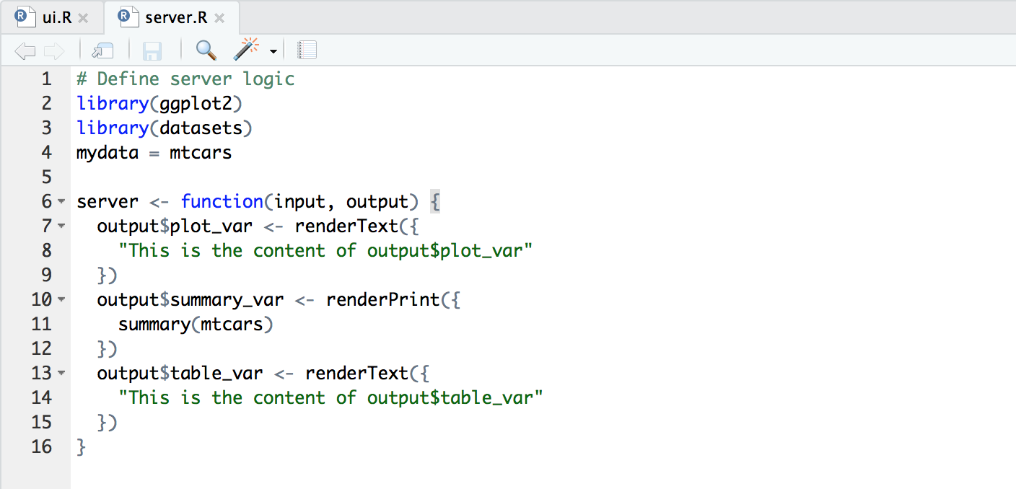

Slide 25
Agenda:
Structure of Shiny apps
Example 1: Basic app, UI elements management, Widgets
Hands-on experience
Example 2: Server function
Hands-on experience
Example 3: Reactivity
Hands-on experience

Slide 26
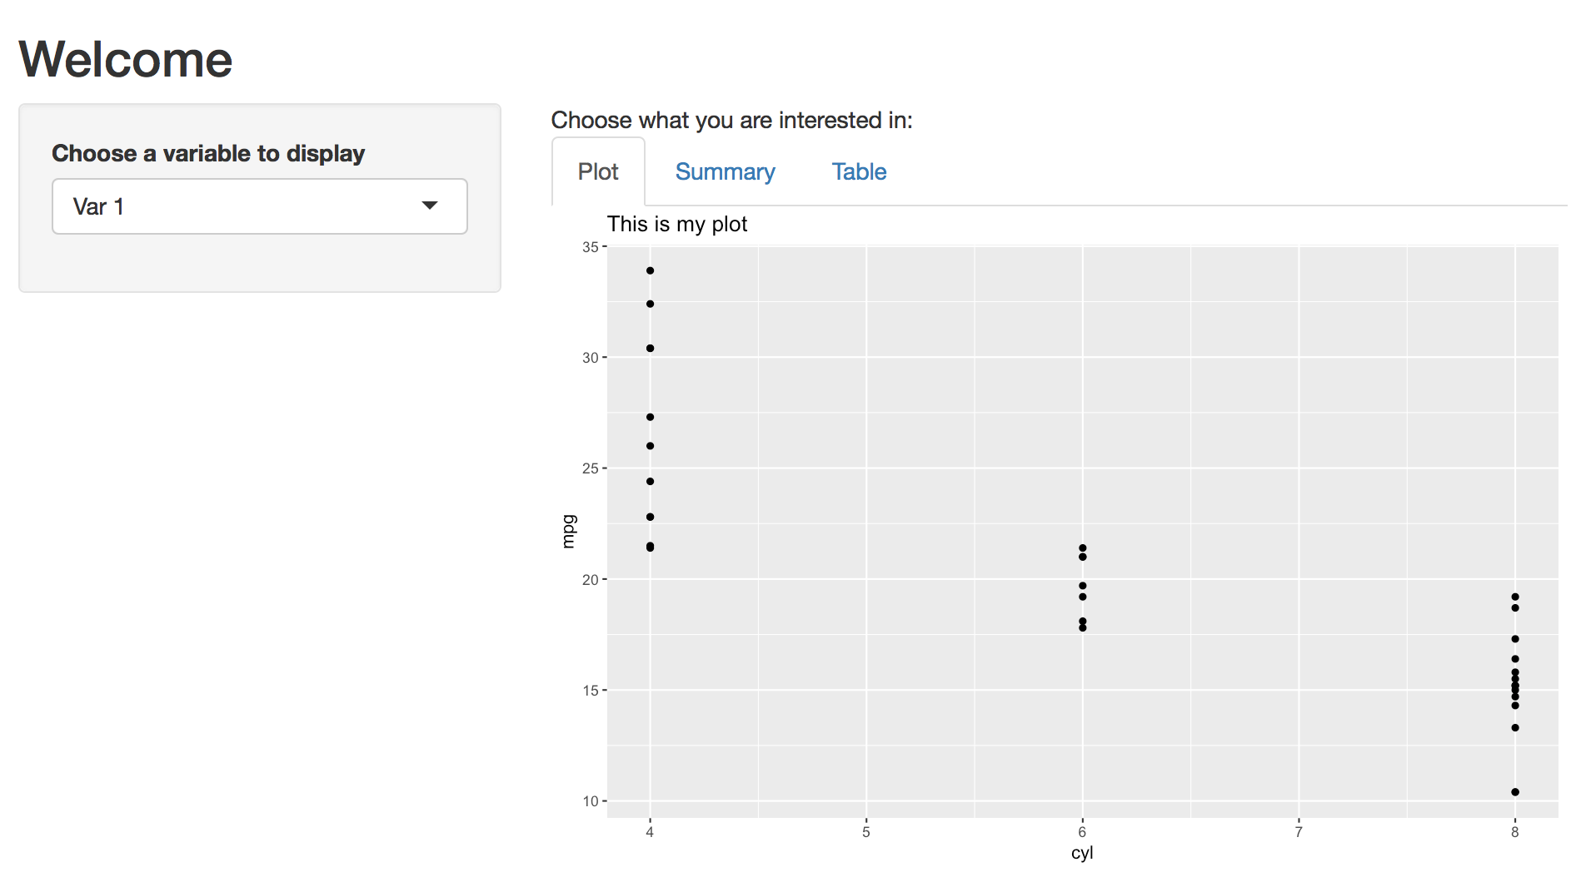
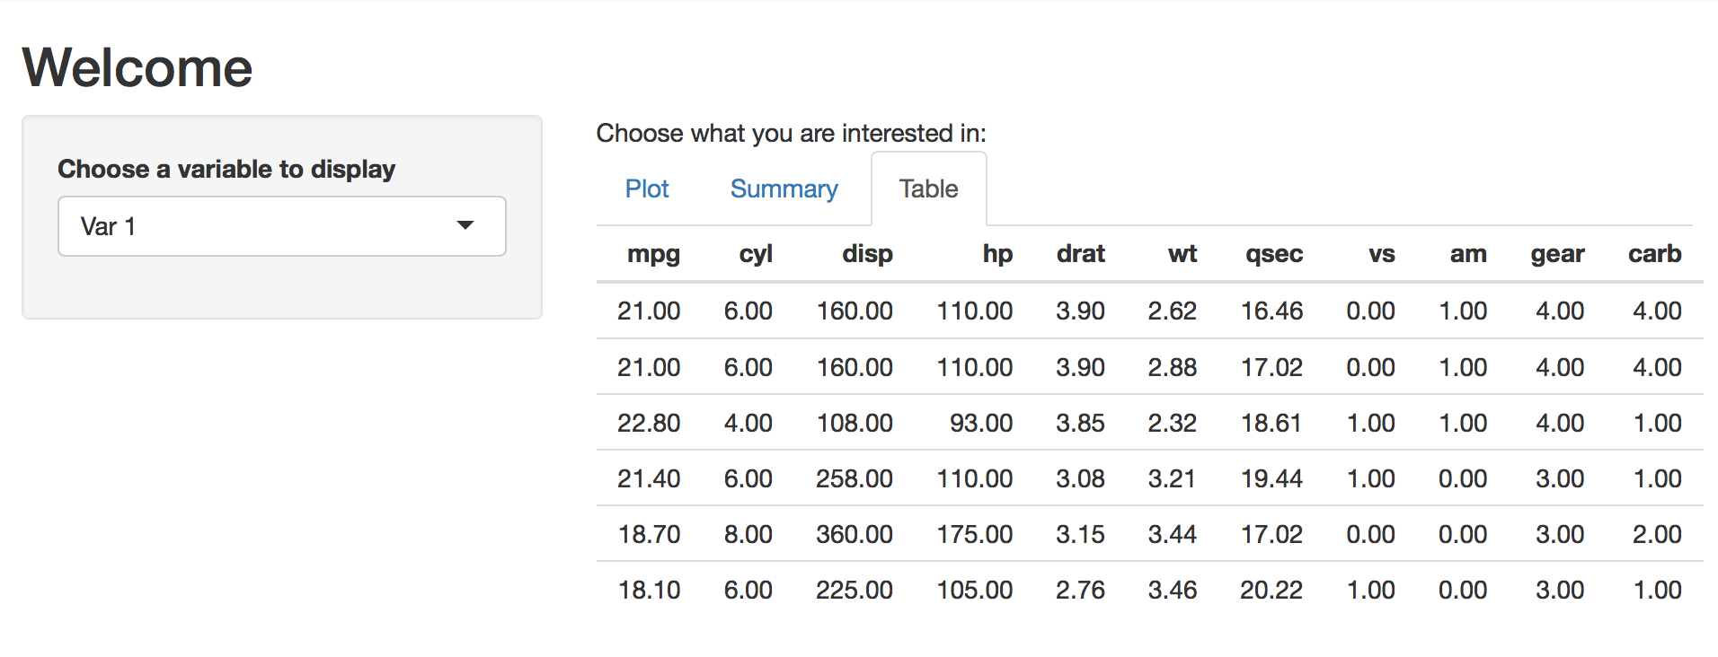
Your turn! Add a plot and a table in the corresponding tabs

